Slide 1
Use of Blogpost data for Marketing
How blogpost data can be used for improving social media marketing

Slide 2
Social Media Marketing
34%
61%
58%
Engage Social Media on a Daily Basis
Use online review from their social media circle
Refer to Ads delivered through Social Media
Social Media Marketing is very important!
* From Deloitte Media Consumer Survey 2016

Slide 3

Data Driven Social Media Marketing
Create own Contents
Brand Image, Followers, Recommendations
Social Media Presence
Brand Image, Exposure,
Ads, Recommendations
Data Analysis

Slide 4

Key findings
Probability of a random post becoming popular
12%
3.9x
Improvement in odds of getting popular posts through:
71
10x
i
Publish on Weekdays
User comments captured per day if 10 posts are selected randomly
ii
4500 – 6500 word Blogs
iii
Using Popular Keywords
Improvement in user captured through predictive modelling

Slide 5
Demo Data
BlogPost Data
Snapshot of a post published at most 72 hours from a certain basetime
Over 60k rows of non-time stamped data from blogposts from 2010 – 2011
Daily data from Feb – Mar 2012 as separate data for model evaluation
1
2
3
4
5
6
Site Data
Comment History
Content Data
Day of week data
Parents Data
Post Popularity
Statistics related to the comments received on the site which hosts the blogpost
Number of comments and links on the post over the last 72 hour period
Length of the post and whether one of the 200 keywords appeared in the post
The day of week when the post was published and when the basetime occurs
Statistics related to the comments in the parent posts (if any)
The number of comment received by the post in the next 24 hours

Slide 6
Data Driven Content Improvement
1
Improved Blog Content to attract more followers
Which day of the week should the blog be published to maximize interest?
2
How long should the blog be to optimize interest?
Are there specific keywords that would attract more interest?
3
Is there a comment threshold that need to be reached before post gathers momentum?
4

Slide 7
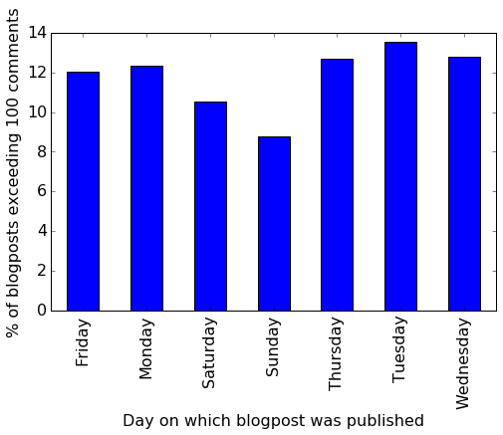
1
Optimizing Publication Date
Post with total comments (comment over last 72 hours plus comments occurring in next 24 hours) greater than 100 is tallied
Publish on weekdays to increase chance of success to 12.7%
Post on Weekdays!

Slide 8
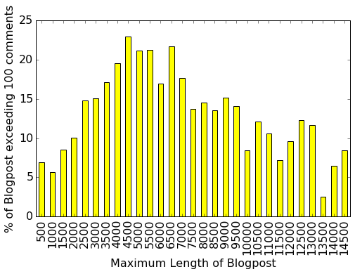
2
Optimizing Content Length
Peak in successful blogpost percentage from 4000 – 6500 words, increasing chance of success to 21%
4000 – 6500 word Blogs!

Slide 9
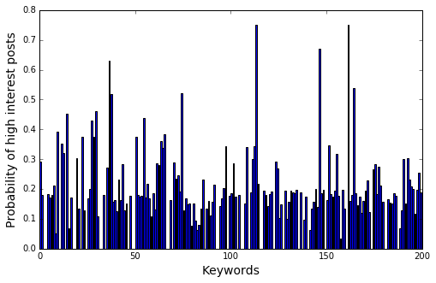
3
Keywords Incorporation
Proportion of high interest posts is significantly higher if some keywords are present
Including the top 20 keywords increases the probability of getting a good post to 35%
Use Popular keywords!

Slide 10
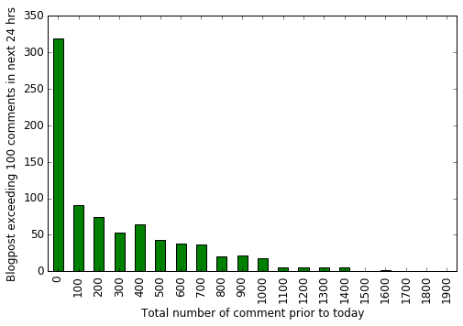
4
Boosting Momentum
Most popular posts do not have prior comments or links
There is no comment threshold

Slide 11
Evaluating Content Improvements
Post with all three features
Posts exceeding 100 comments
697
328
Publish on Weekdays: 12.6%
4500- 6500 Words Blog: 21%
Improved Posts
47%
Top 20 Keywords: 35%
Probability of an improved post becoming popular: 3.9x the baseline value

Slide 12
Prediction of blogpost of most interest
Task: Predict posts that receive more than 50 comments over the next 24 hours
Data
Train
Evaluate
Item 2
Tune
Use Data from 1 Feb – 15 Feb 2012
Fine tune model parameters
Use Data from Mar 2012
Make prediction and evaluate accuracy
Use Data from 2010 - 2011
Ignore Site Data and Parent Data
Four Different Models

Slide 13
Model Scores
High interest Blogpost correctly identified (Recall)
Model wellness score (ROC AUC)
Predicted blogpost actually generate high interest (Precision)

Slide 14
Predictive Model Driven Commenting
Place Link to the top post on our blog (Top 1)
Genuine and personal comment on top posts (Top 5)
Place generic Ads and Comments on all interesting posts (All)
Select best posts for additional real time modelling (as many as we believe are true positives)
Daily Model Prediction (i.e. 24 hour life cycle)

Slide 15
Performance of Predictive Models
Captured Comments from Selecting 1 post
Captured Comments from Selecting 5 posts
Captured Comments for selecting all positive posts
Captured percentage based on precision
Best Predictions captures at least 10 times more comments than random selection

Slide 16
Conclusions and Recommendations
Finding 1: Blogpost Data can be used to provide guidelines that improve the odds of popularity of 3.9 times
Finding 2: Blogpost Data can be used to create prediction model that captures 10 times more comments than randomly selected posts
Recommendation 1: Follow guidelines in this presentation for content design, and use predictive model to perform first 3 tasks presented
Recommendation 2: Acquire all data available from provider as well as acquire method in which the data is extracted from posts
Recommendation 3: Acquire additional data such as image classification, Number of Clicks, sentiment analysis etc to refine prediction models

